Slide 1
African American/Black History Month
February 2021
The Black Family: Representation, Identity, and Diversity

Slide 2
The History of African American/Black History Month
Who: Carter G. Woodson
What: Over the years, the themes reflect changes in how people of African descent in the United States have viewed themselves, the influence of social movements on racial ideologies, and the aspirations of the black community.
When: Negro History Week est. 1926; Black History Month est. 1976
Why: “Perhaps there would be no need to observe black history in a designated month if it were taught year-round, alongside other histories as part of a regular curriculum. It wouldn’t be such a novelty if there were a rigorous effort to view it as a central part of the American story. But we aren’t there yet. Black History Month should be recognized as a crucial opportunity to broaden students’ knowledge and help them see how the past connects with their lives today—and how it has inspired movements for change.” - Coshandra Dillard

Slide 3
Did You Know?

Slide 4
Claudette Colvin, a 15 yr old girl, refused to give up her seat on a bus nine months before Rosa Parks engaged in that act of resistance.
Hiram Revels, the first Black US Senator, took office in 1870.
Onesimus, an enslaved man, introduced Inoculation to America.
Bessie Coleman was the first licensed African American female pilot.
Bayard Rustin was an LGBTQ and civil rights activist best known for being a key adviser to Reverend Martin Luther King Jr. He organized the 1963 March on Washington and was posthumously awarded the Presidential Medal of Freedom, the nation’s highest civilian honor, in 2013 for his activism.
Barbara Jordan, a civil rights leader and attorney, became the first African American elected to the Texas Senate in 1966, and the first woman and first African American elected to Congress from Texas in 1972.

Slide 5
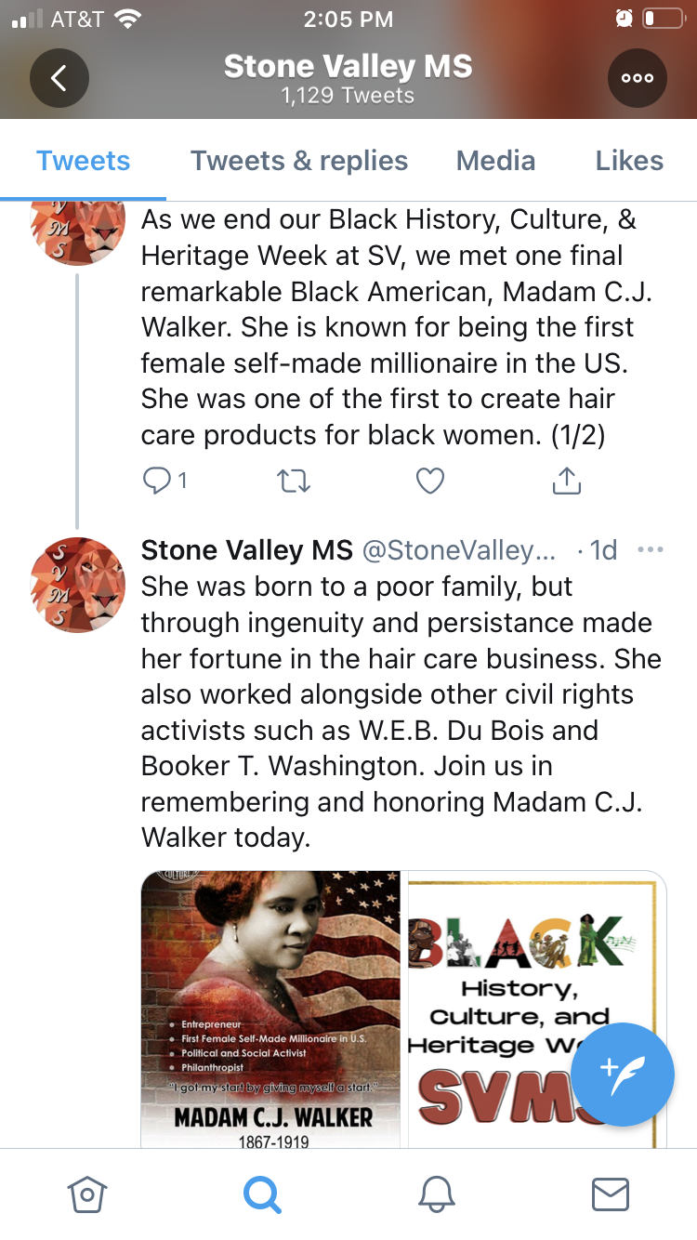

Slide 6
“My humanity is bound up in yours, for we can only be human together.”
—Desmond Tutu

